Slide 1

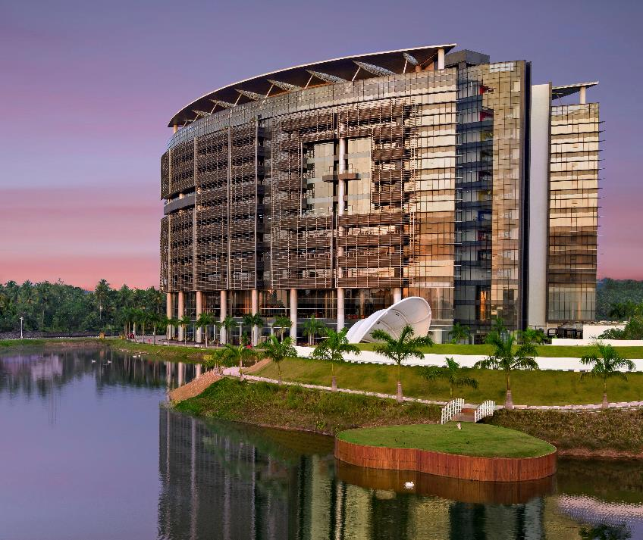
RABBITMQ AND APACHE KAFKA
TEAM:
MIRACLE TECHIES
05/06/2023

Slide 2
RabbitMQ

Slide 3
RabbitMQ: Introduction
It is a message broker that originally implements the Advance Message Queuing Protocol (AMQP)
AMQP standardizes messaging using Producers, Broker and Consumers.
AMQP standards was designed with the following main characteristics:
Security
Reliability
Interoperability

Slide 4
RabbitMQ: Key Features
Security: Supports authentication, authorization, LDAP and TLS via RabbitMQ plugins.
Reliability: Confirms the message was successfully delivered to the message broker and confirms that the message was successfully processed by the consumer.
Interoperability: Message is transferred as stream of bytes so any client can operate on it irrespective of any languages.

Slide 5
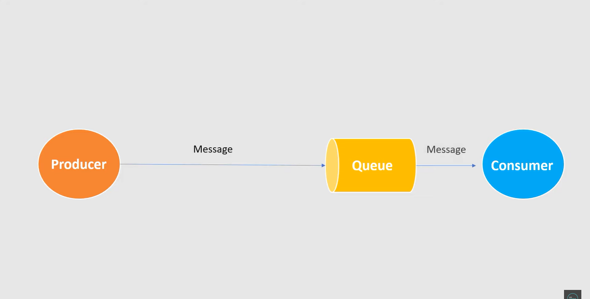
Traditional Message Queuing System

Slide 6
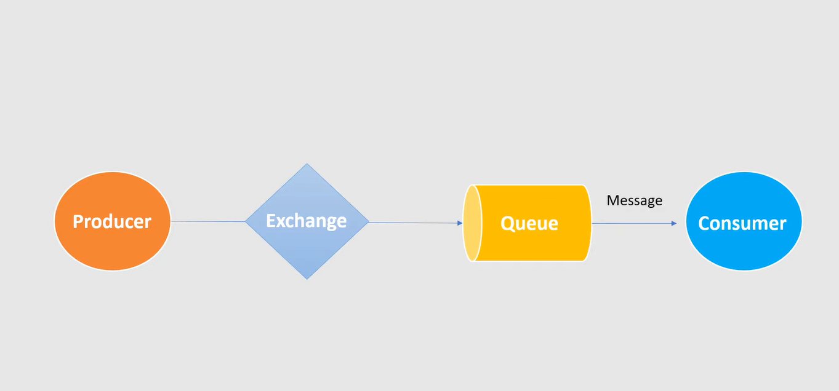
Message Queuing using RabbitMQ: Single Queue

Slide 7
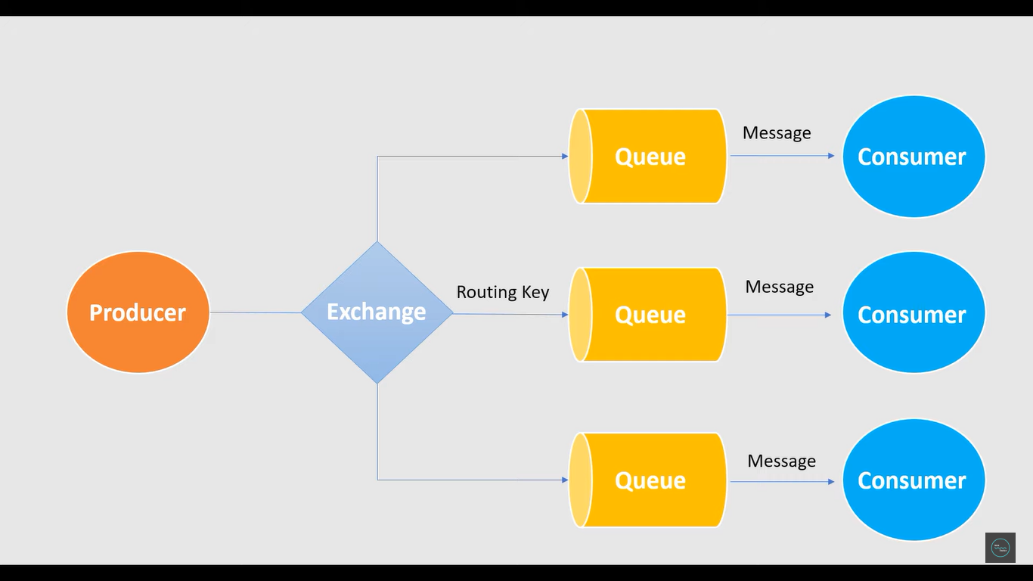
Message Queuing using RabbitMQ: Multiple Queues

Slide 8
RabbitMQ: Installation
The default port number for RabbitMQ is localhost:15672
To run the RabbitMQ server run the following command in CMD:
docker run -it --rm --name rabbitmq -p 5672:5672 -p 15672:15672 rabbitmq:3.11-management
Then go to localhost 15672 which will open the RabbitMQ page
Login to it with username and password as "guest"

Slide 9
Advantages of RabbitMQ
Reliability: RabbitMQ provides robust message delivery mechanisms, including message acknowledgments, durable queues, and persistent messages.
Scalability: RabbitMQ supports horizontal scaling by distributing messages across multiple queues or nodes. This allows you to handle increased workloads and ensures efficient message processing even in high-traffic scenarios.
Asynchronous Communication: RabbitMQ enables asynchronous communication between different components of an application or between distributed systems
Protocol Support: RabbitMQ supports multiple messaging protocols, including AMQP, MQTT, and STOMP

Slide 10
Disadvantages of RabbitMQ:
Complexity: Setting up and configuring RabbitMQ can be complex, especially for beginners. Understanding concepts like exchanges, queues, bindings, and routing can require some learning curve.
Operational Overhead: Running and managing a RabbitMQ cluster requires operational expertise
Network Dependencies: RabbitMQ relies on network connectivity between producers, consumers, and the message broker itself.
Performance Impact: While RabbitMQ is known for its reliability and flexibility, it may introduce some performance overhead due to the additional layers of message processing and handling.

Slide 11
Applications of RabbitMQ
Message Queuing: RabbitMQ is widely used for implementing message queues in distributed systems. It provides reliable and scalable message queuing capabilities, allowing producers to send messages to exchanges, which are then routed to queues and consumed by subscribers.
Interoperability and Integration: RabbitMQ supports various messaging protocols, including AMQP, MQTT, and STOMP. This makes it suitable for integrating with different systems and platforms, enabling seamless communication between heterogeneous components.
Log Aggregation and Processing: RabbitMQ can be utilized for log aggregation and processing in distributed systems.

Slide 12
Apache Kafka

Slide 13
What is Kafka?
Apache Kafka is a distributed publish-subscribe messaging system and a robust queue that can handle a high volume of data and enables you to pass messages from one end-point to another
Kafka is suitable for both offline and online message consumption.
Kafka messages are persisted on the disk and replicated within the cluster to prevent data loss
Kafka is built on top of the Zookeeper synchronization service.
It integrates very well with Apache Storm and Spark for real-time streaming data analysis.

Slide 14
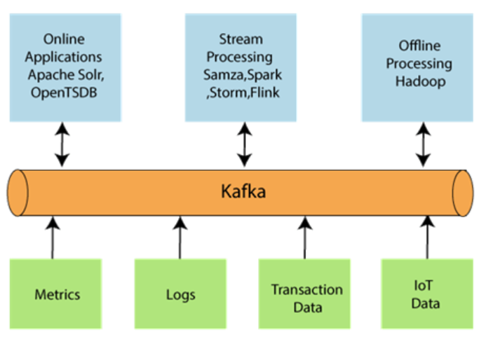
Apache Kafka Architecture
These are the following essential parts required to design Apache Kafka architecture:-
Data Ecosystem: Several applications that use Apache Kafka forms an ecosystem. This ecosystem is built for data processing.

Slide 15
Kafka Cluster: A Kafka cluster is a system that comprises of different brokers, topics, and their respective partitions.
Producers: A producer sends or writes data/messages to the topic within the cluster.
Consumers: A consumer is the one that reads or consumes messages from the Kafka cluster.
Brokers: A Kafka server is known as a broker. A broker is a bridge between producers and consumers.
Topics: It is a common name or a heading given to represent a similar type of data.
Partitions: The data or message is divided into small subparts, known as partitions. Each partition carries data within it having an offset value. The data is always written in a sequential manner.
ZooKeeper: A ZooKeeper is used to store information about the Kafka cluster and details of the consumer clients. It manages brokers by maintaining a list of them. Also, a ZooKeeper is responsible for choosing a leader for the partitions.

Slide 16
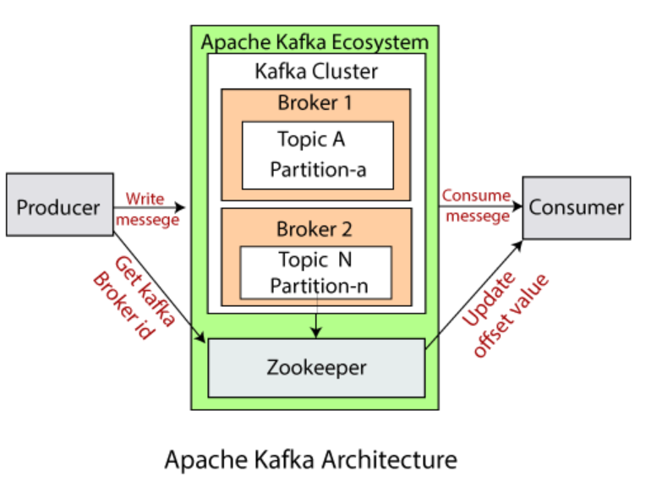

Slide 17
Apache Kafka Streams
Apache Kafka Streams is a library provided by Apache Kafka for building real-time stream processing applications. It allows developers to process and analyze continuous streams of data directly within the Kafka ecosystem, without the need for external processing frameworks or databases.
Key features to Apache Kafka Streams:-
Kafka Streams are highly scalable as well as elastic in nature.
Can be deployed to containers, cloud, bare metals, etc.
It is operable for any size of use case, i.e., small, medium, or large.

Slide 18
It has the capability of fault tolerance. If any failure occurs, it can be handled by the Kafka Streams.
It allows writing standard java and scala applications.​
For streaming, it does not require any separate processing cluster.​
Kafka Streams are supported in Mac, Linux, as well as Windows operating systems.​
It does not have any external dependencies except Kafka itself.​

Slide 19
Kafka Security
There can be several consumers which can read data from the Kafka and producers which can produce data. But it is necessary to ensure the security of data.
Components of Kafka Security:-
Mainly, there are three major components of Kafka Security:
Encryption: The exchange of data between the Kafka broker and clients is kept secure through encryption. Kafka encryption ensures that no other client could intercept and steal or read data. The data will be shared in an encrypted format only.

Slide 20
Authentication: This ensures the connection of various applications with the Kafka brokers. Only the applications which are authorized will be able to publish or consume messages. The authorized applications will have their respective user id and password to access the message from the cluster.​
Authorization: This comes after authentication. When the client becomes authenticated, it is allowed to publish or consume messages. The applications can also be restricted from write access to prevent data pollution.​

Slide 21
Benefits
Reliability − Kafka is distributed, partitioned, replicated and fault tolerance.
Scalability − Kafka messaging system scales easily without down time.
Durability − Kafka uses Distributed commit log which means messages persists on disk as fast as possible, hence it is durable.
Performance − Kafka has high throughput for both publishing and subscribing messages. It maintains stable performance even many TB of messages are stored.

Slide 22
Use Cases​
Metrics − Kafka is often used for operational monitoring data. This involves aggregating statistics from distributed applications to produce centralized feeds of operational data.
Log Aggregation Solution − Kafka can be used across an organization to collect logs from multiple services and make them available in a standard format to multiple consumers.
Stream Processing − Popular frameworks such as Storm and Spark Streaming read data from a topic, processes it, and write processed data to a new topic where it becomes available for users and applications.

Slide 23
THANK YOU

